Slide 1
Southeast Fisheries Science Center’s Research and Monitoring Priorities
James A. Bohnsack, Ph.D. Director, Protected Resources and Biodiversity Division NOAA National Marine Fisheries Service
South Florida Caribbean – Cooperative Ecosystem Studies Unit
(SFC–CESU) Program
21 October 2016, Miami, FL

Slide 2
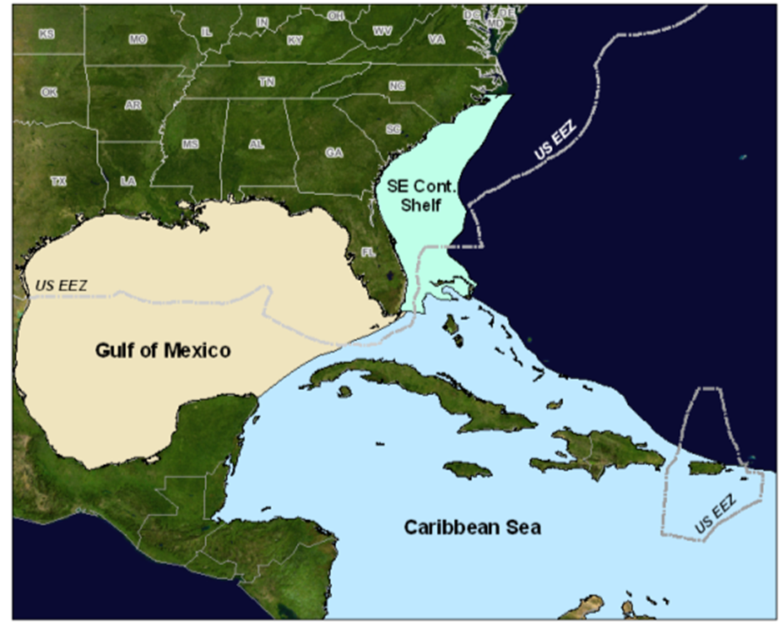
Southeast U.S.
Large Marine Ecosystems
& US Jurisdictions
Tropical Western Atlantic
& high seas
Navassa Is.
Puerto Rico USVI
Notes:
Areas of responsibility: Miami is located on an ecotone of 3 LMEs.& High Seas

Slide 3
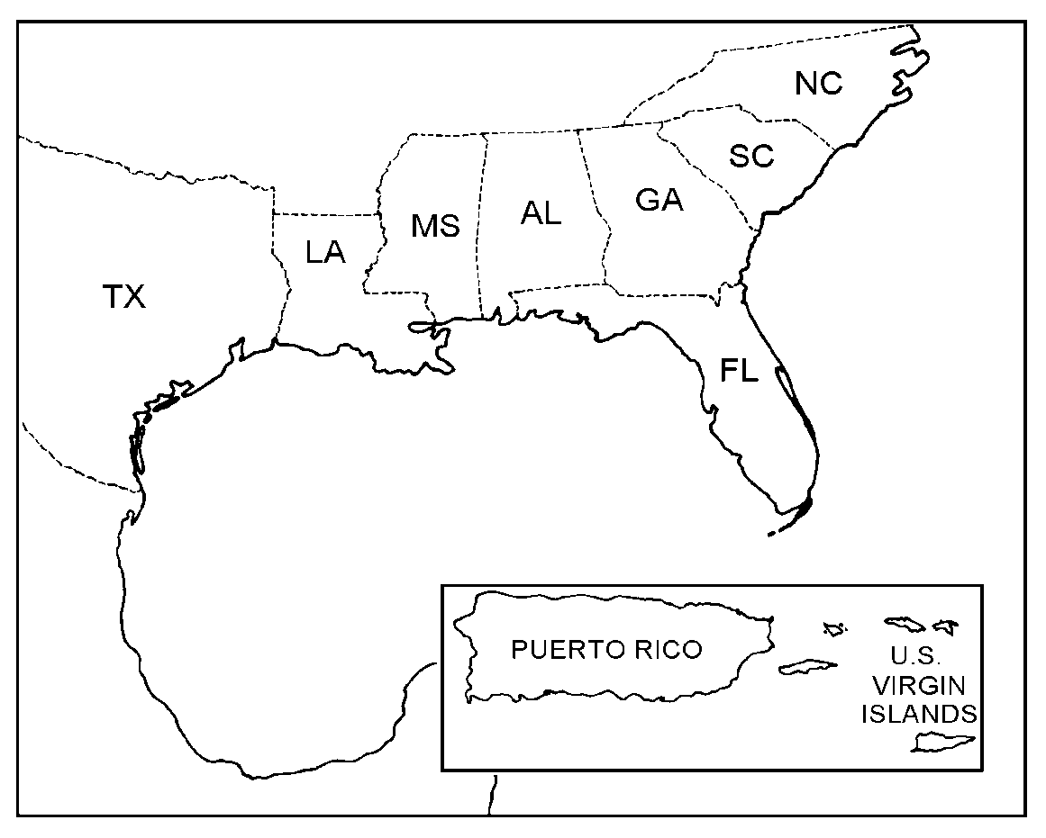
SEFSC Organization Structure
Beaufort,
NC
Pascagoula, MS
Miami, FL
Galveston,
TX
Galveston, TX
Panama
City, FL
Lafayette,
LA
Panama City, FL
MS Labs
Stennis &
Pascagoula
SERO,
St.
Petersburg
Entire Region
Miami, FL

Slide 4
Strategic Goals from NOAA’s Next Generation Strategic Plan
Healthy Oceans
Marine fisheries, habitats, and biodiversity
Sustained within healthy and productive ecosystems

Slide 5
SEFSC Research Themes and Objectives
Ecosystem-based Management
Improve understanding of ecosystems to support resource management decisions
Resource Protection & Restoration Recover coastal and marine protected species
Climate Research & Impacts
Ensure healthy habitats that sustain resilient and thriving marine resources and communities

Slide 6
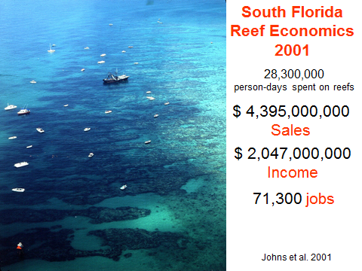
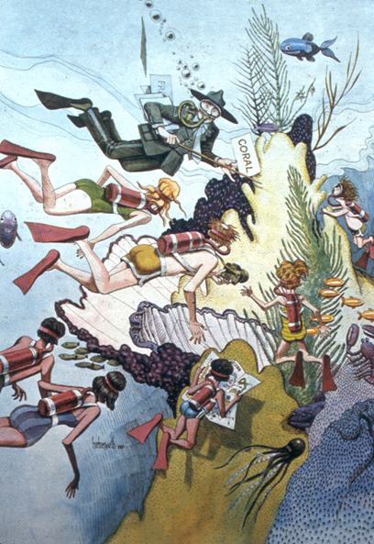
It is not just about fish
Ecosystem Services
Commercial Fishing
Recreation
Fishing, Diving, & Snorkeling
Tourism
Coastal Protection
Wilderness
Habitat & Biodiversity
Research & Education
Marine Industries
Johns, G.M, V.R. Leeworthy, F.W. Bell, M.A. Bonn. 2001. Socioeconomic Study of Reefs in Southesast Florida.
Photo: J.A. Bohnsack 1983 Looe Key Reef
Notes:
Reefs provide valuable ecosystem goods and services in all three SEUS LMEs.

Slide 7
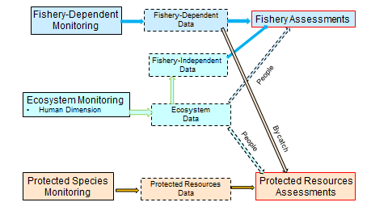
Challenge: Environmental Data Collection
Ecosystem–based management requires adequate environmental data to detect and determine causes of change.

Slide 8
SEFSC Current and Recent Activities
Deep Water Horizon Damage Assessment and Restoration
ESA Protected Species Monitoring and Recovery
Marine Mammals, Sea Turtles, Corals (7),
Fishes (sturgeon, Nassau groper, sawfish, hammerhead shark)
Johnson Seagrass
Ecosystem-Based Fishery Management
Integrated Ecosystem Assessments (IEA)
Management Strategy Evaluation (MSE)
Improved Fishery Dependent and Independent Monitoring
Climate Vulnerability Assessment (Gulf of Mexico)
Habitat monitoring and assessments (Corals)

Slide 9
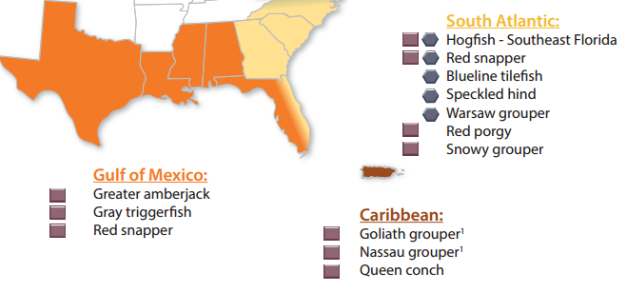
SE Stocks Overfished and Undergoing Overfishing
NOAA Fisheries Quarter 4 Update Stock Status as of December 31, 2015
Fish Stock Sustainability Index (FSSI):
Notes:
NOAA Fisheries measures the performance of U.S. federal fisheries through the Fish Stock Sustainability Index (FSSI). First implemented in 2005, the FSSI is a quarterly index that currently includes 199 fish stocks selected because of their importance to commercial and recreational fisheries. The FSSI measures the performance of these important fish stocks, which represent 85 percent of total catch.

Slide 10
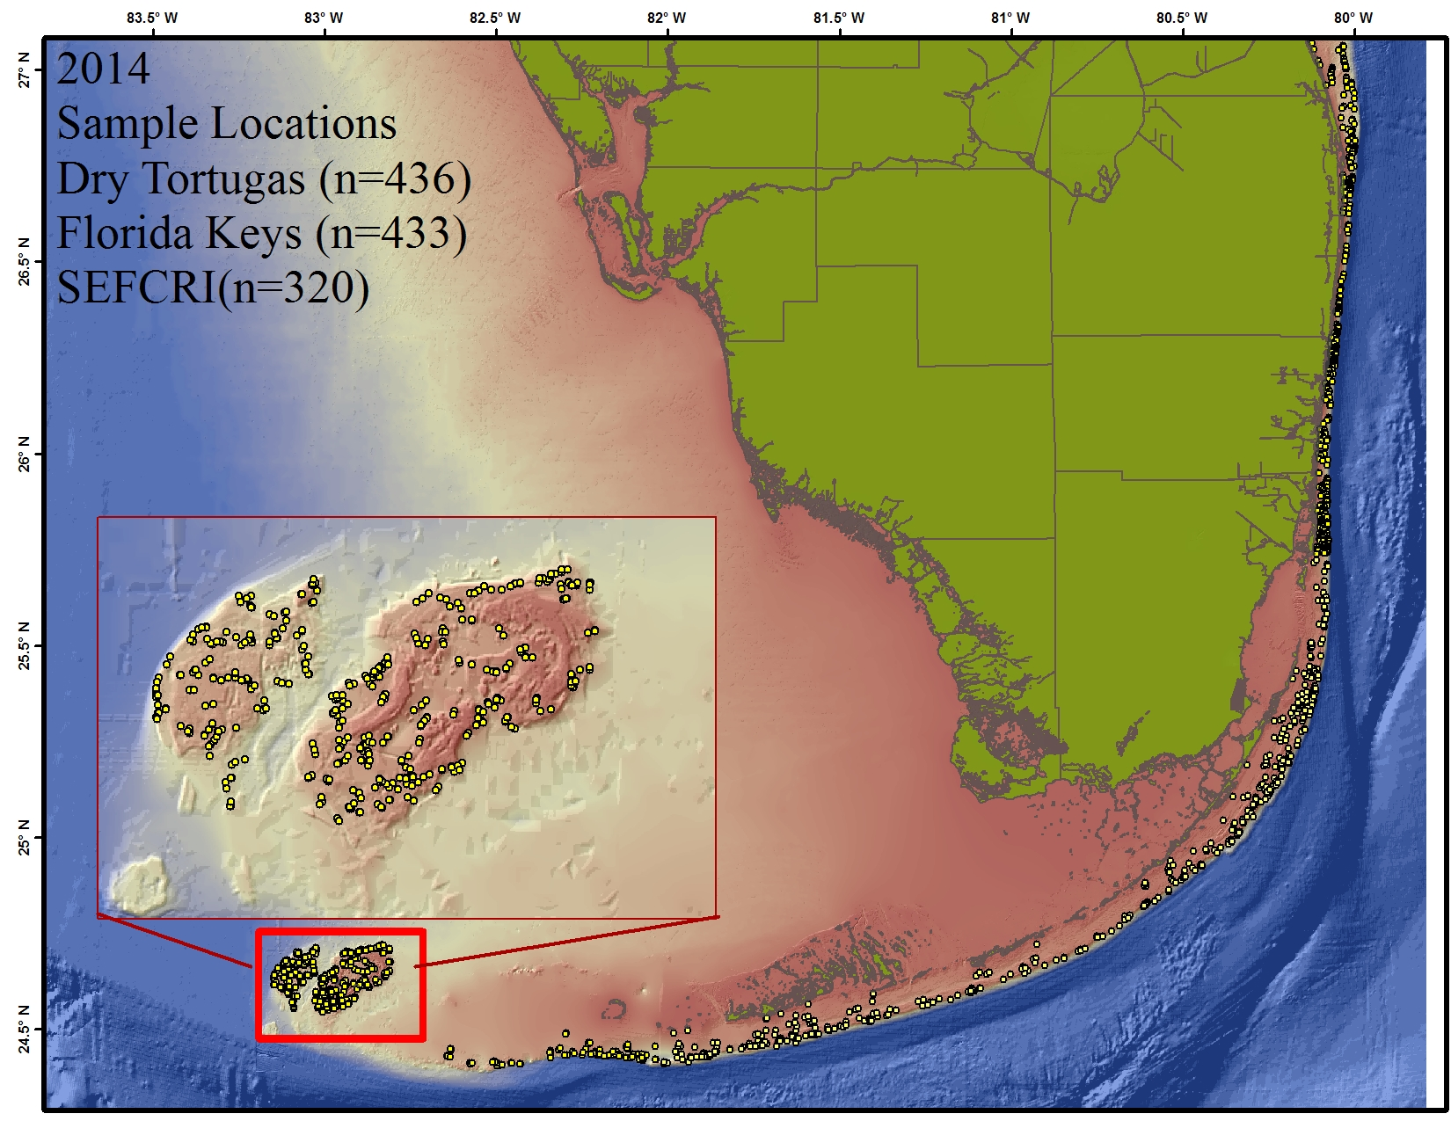
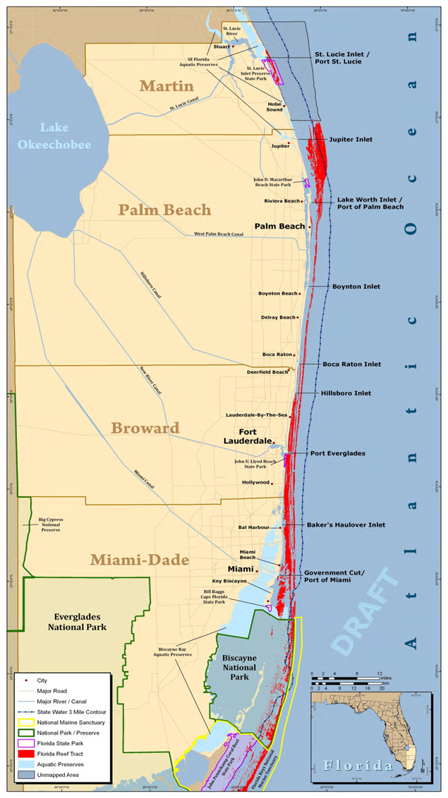
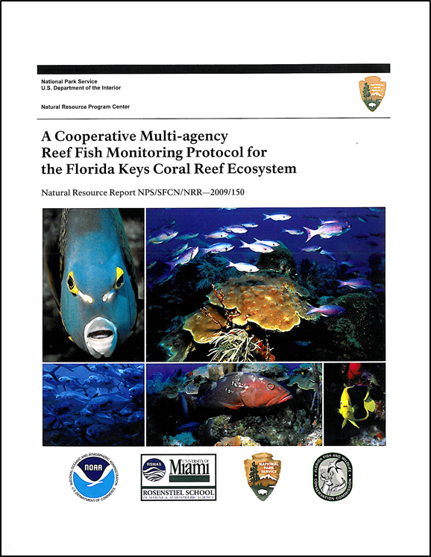
2014 Samples by Domain
(n = 436) Dry Tortugas (810 km ²) 1999 - 2014
(n = 433} Florida Keys (500 km ²) 1980 - 2014
(n = 320) SE Fla Coast (253 km ²) 2013 - 2015
SE Fla
Florida Keys
Dry Tortugas

